Slide 1

Restaurant Predictor
Aria Askaryar
&
Akshay Sakpal

Slide 2



Topic and Summary
Descriptive and Predictive Data Analysis of Open Source Restaurant Data
The primary aim is to utilize machine learning algorithms to extract valuable insights from data and forecast the likelihood of a new restaurant's success.

Slide 3







Tools
Python (Pyspark, Pandas, Numpy, matplot)
Streamlit
Machine Learning scikit-learn
spark
Zomato dataset: https://www.kaggle.com/datasets/himanshupoddar/zomato-bangalore-restaurants
Algorithms Linear Regression

Slide 4
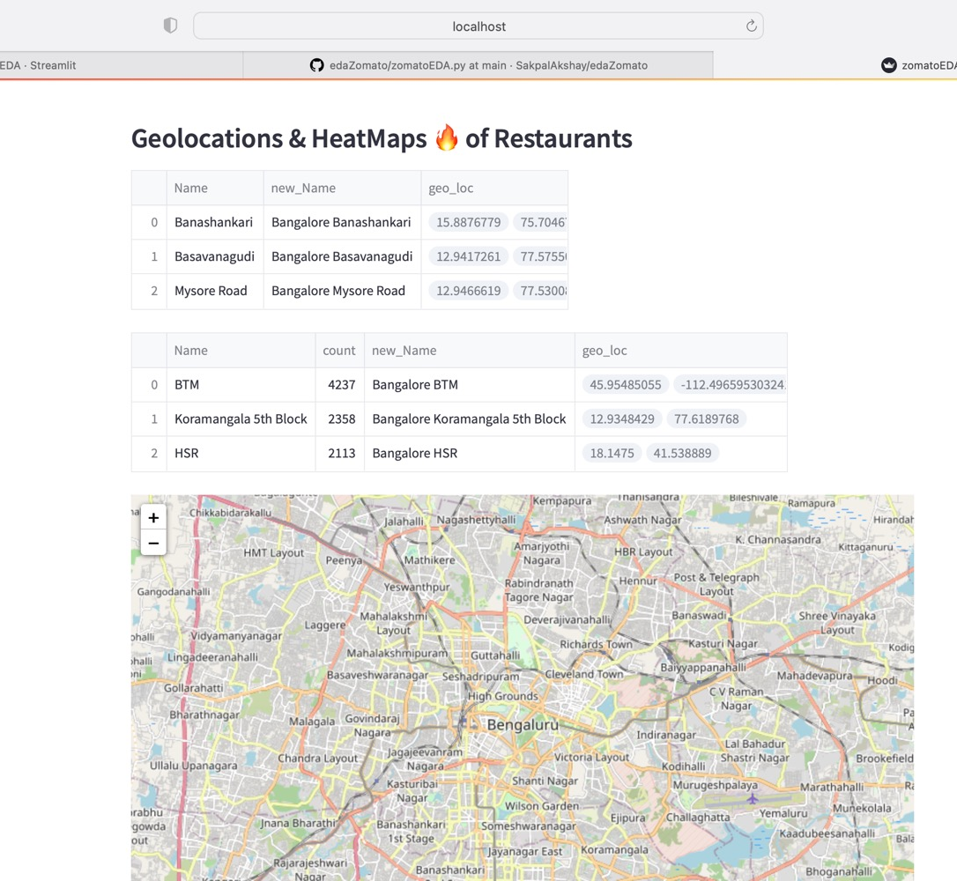
Geolocations & HeatMaps

Slide 5
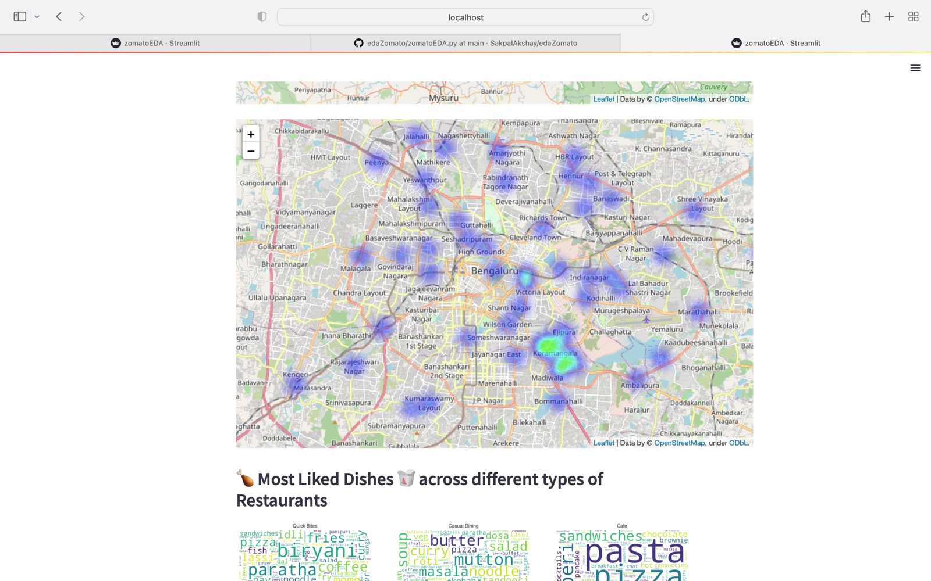

Slide 6
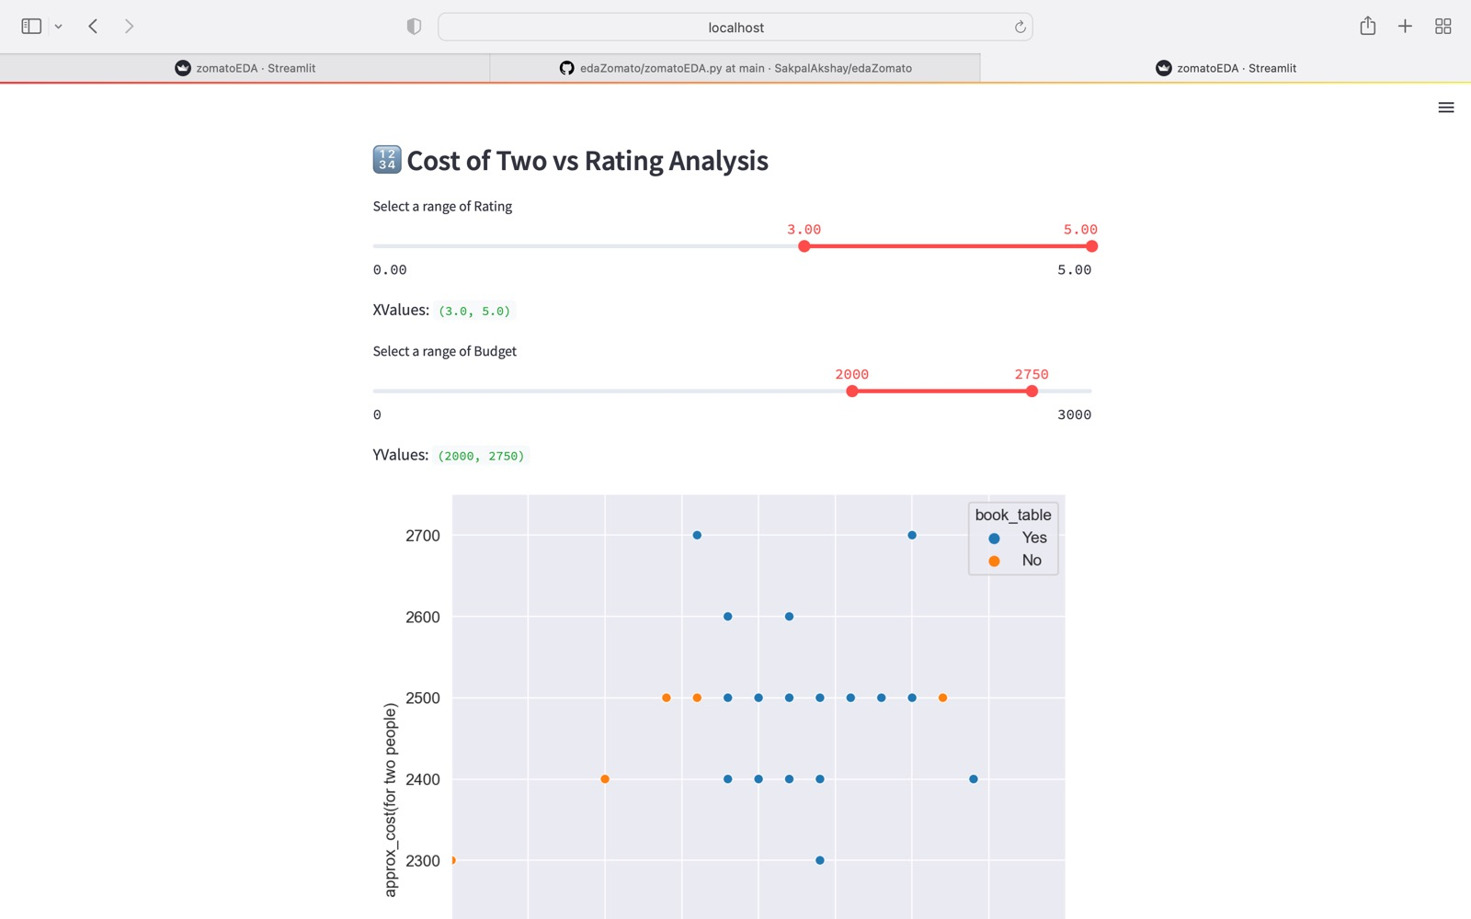

Slide 7
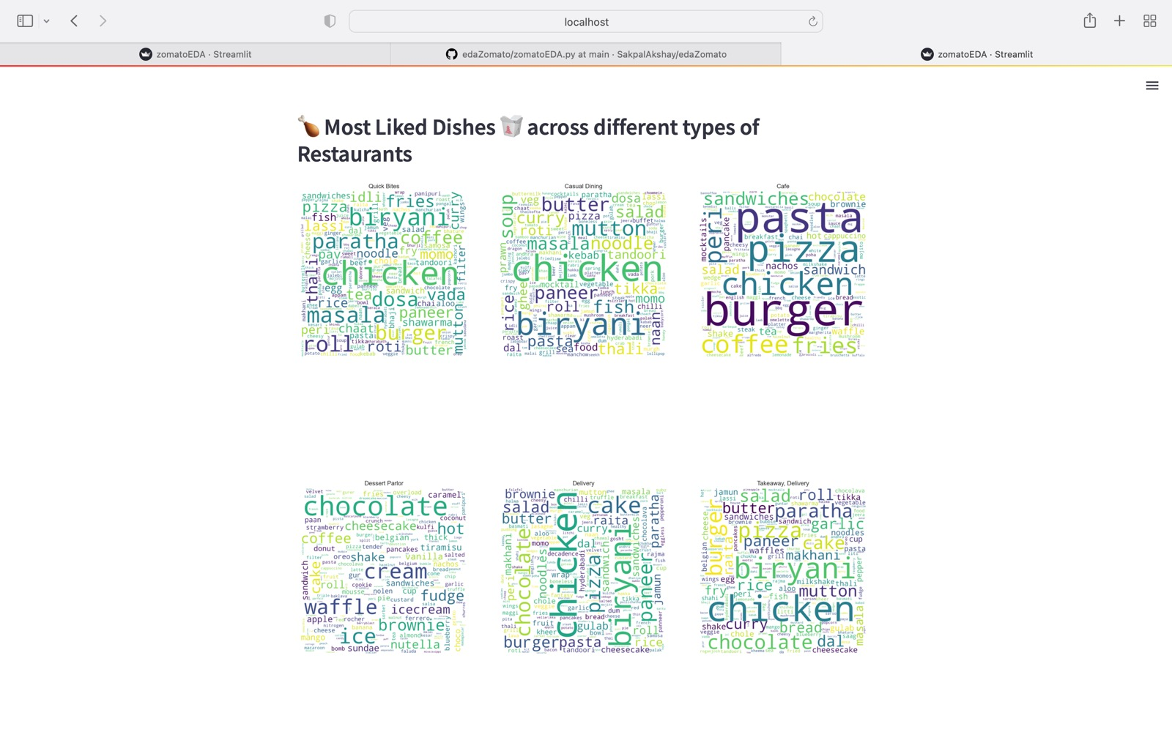

Slide 8
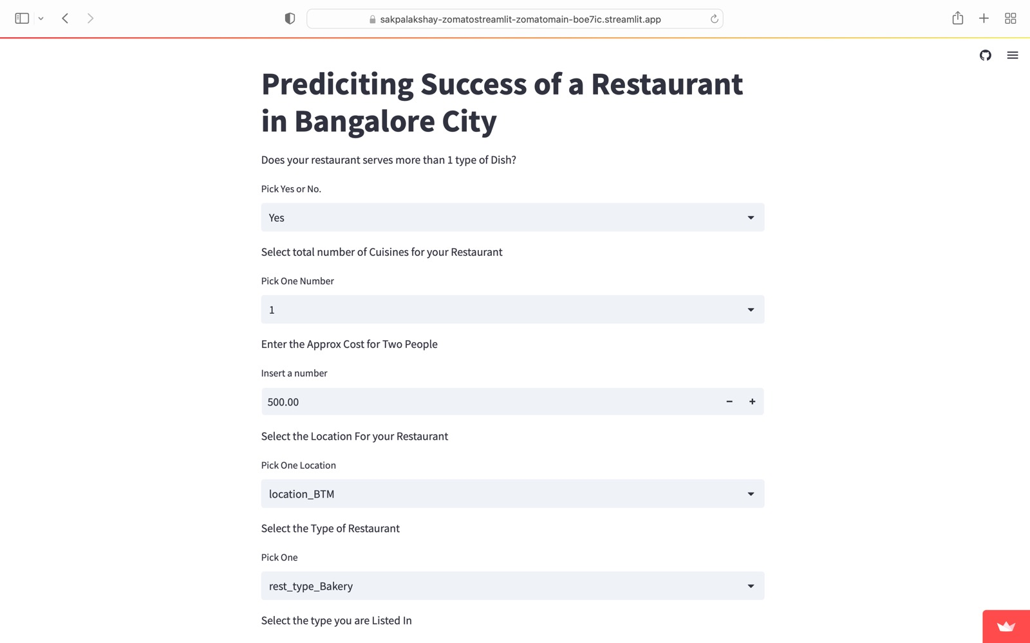
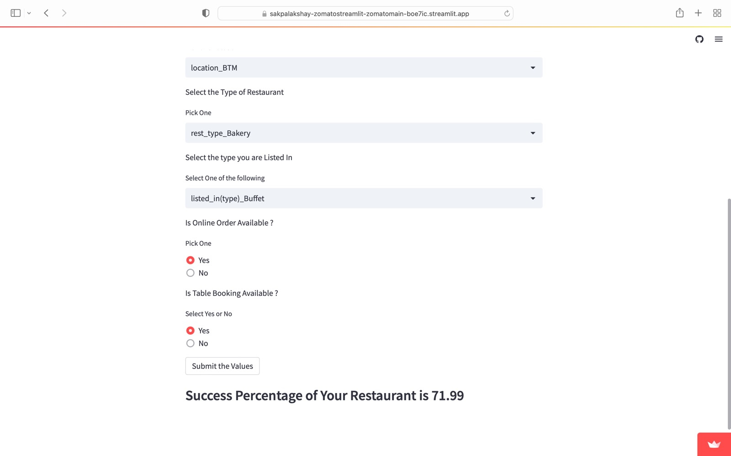

Slide 9
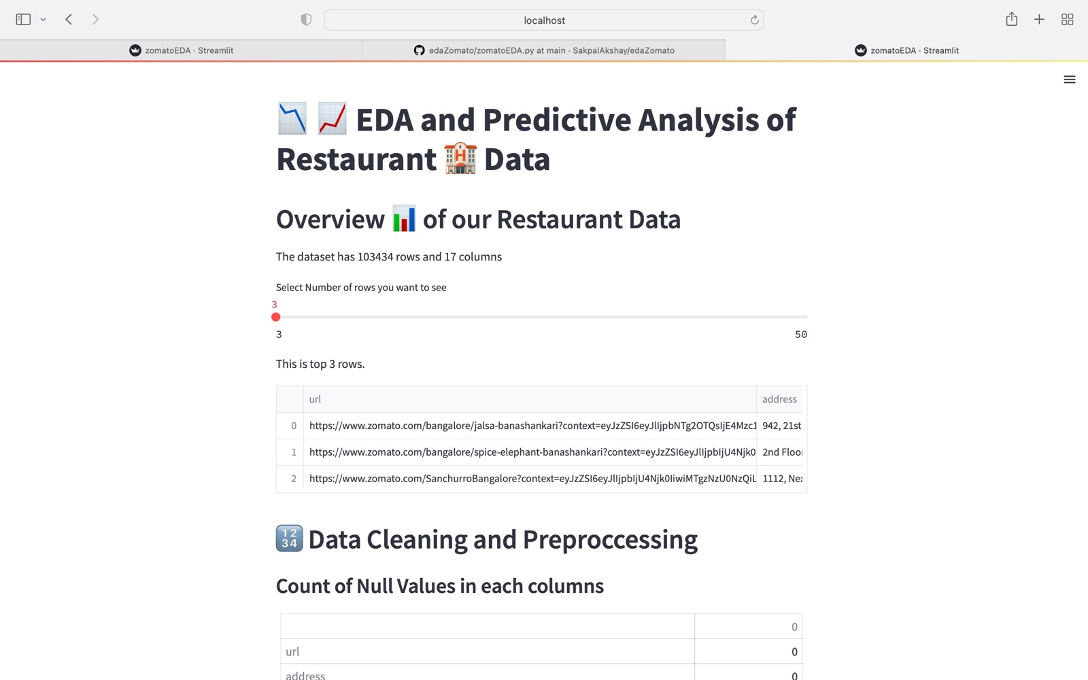

Slide 10
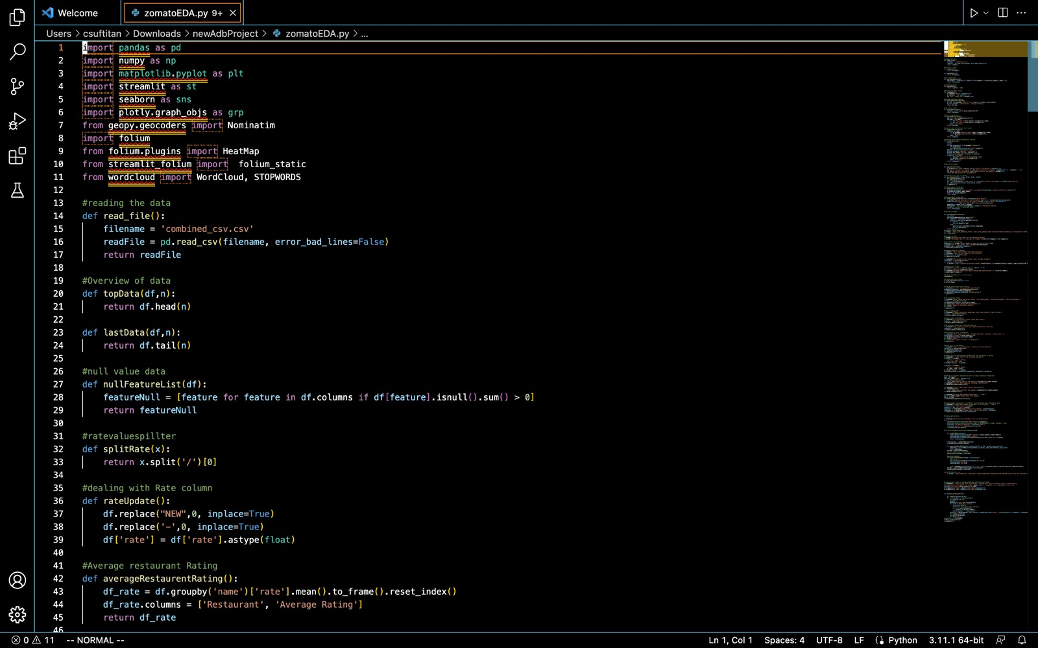
Subtitle

Slide 11
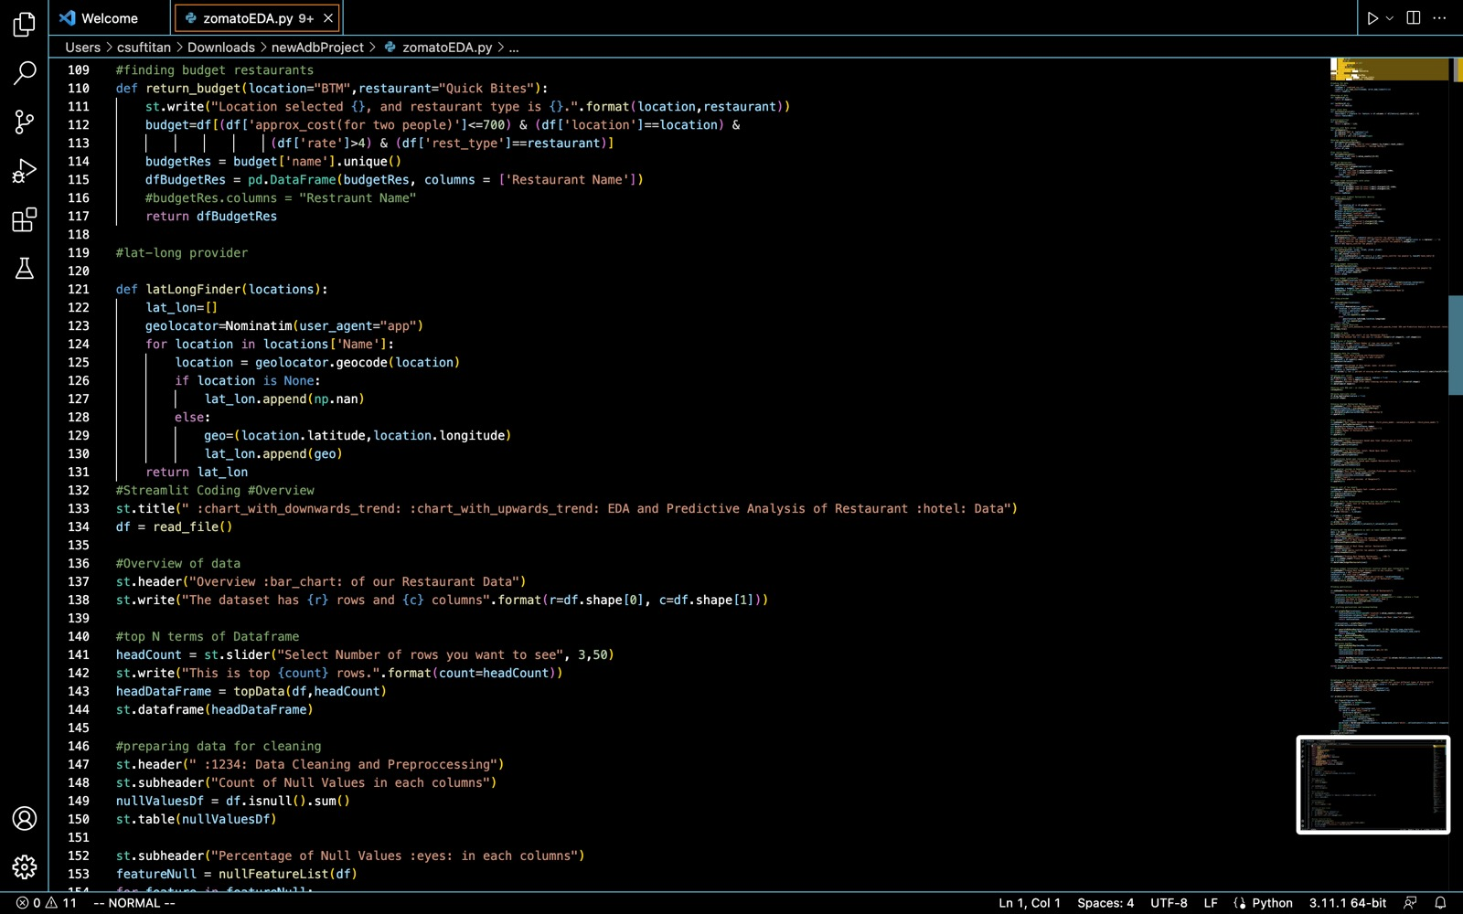

Slide 12
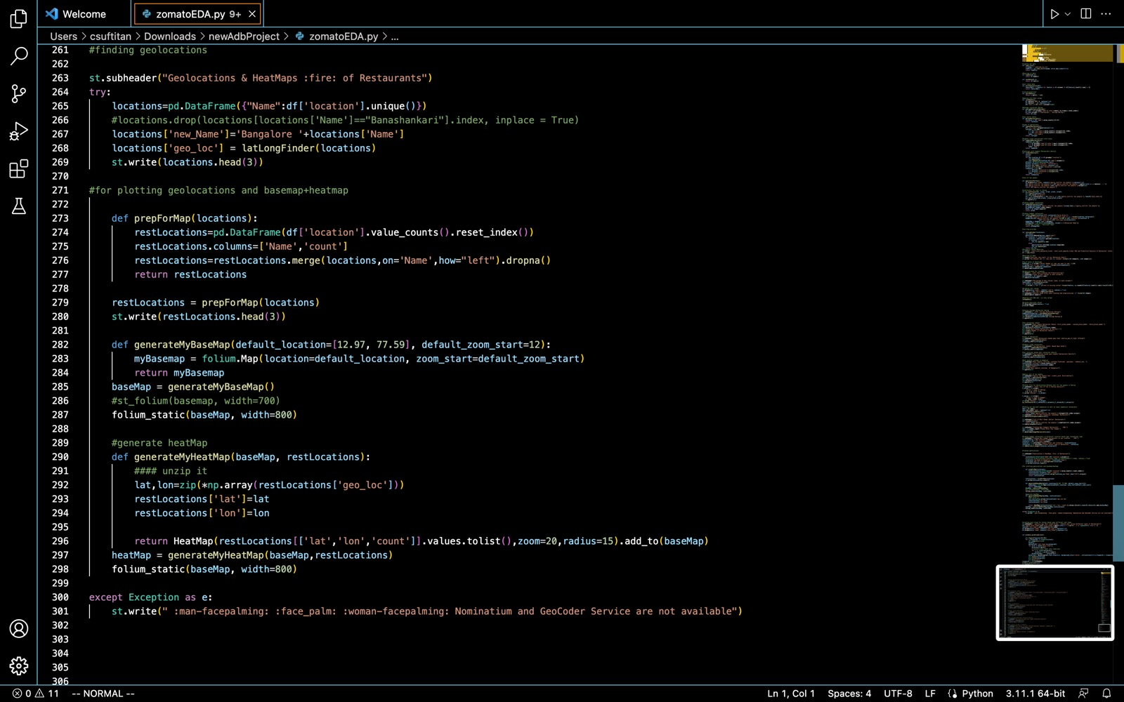

Slide 13
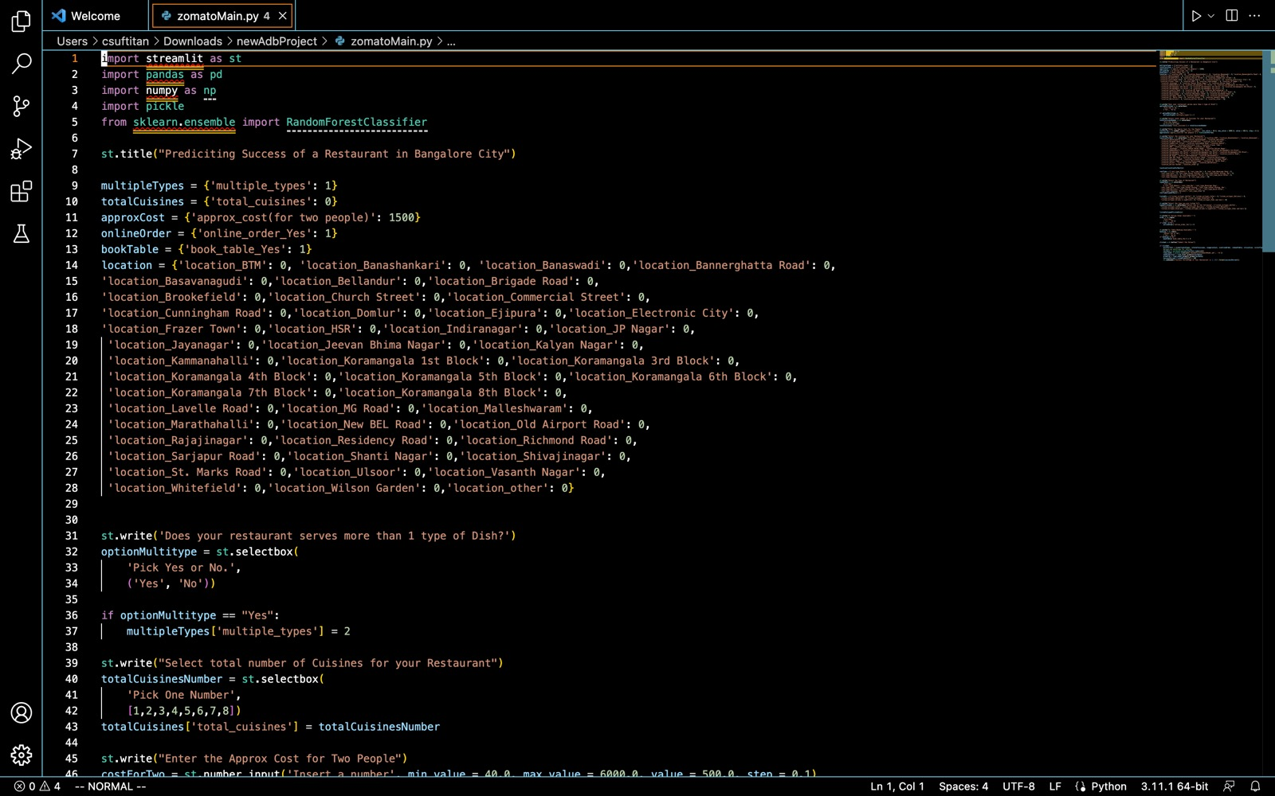

Slide 14
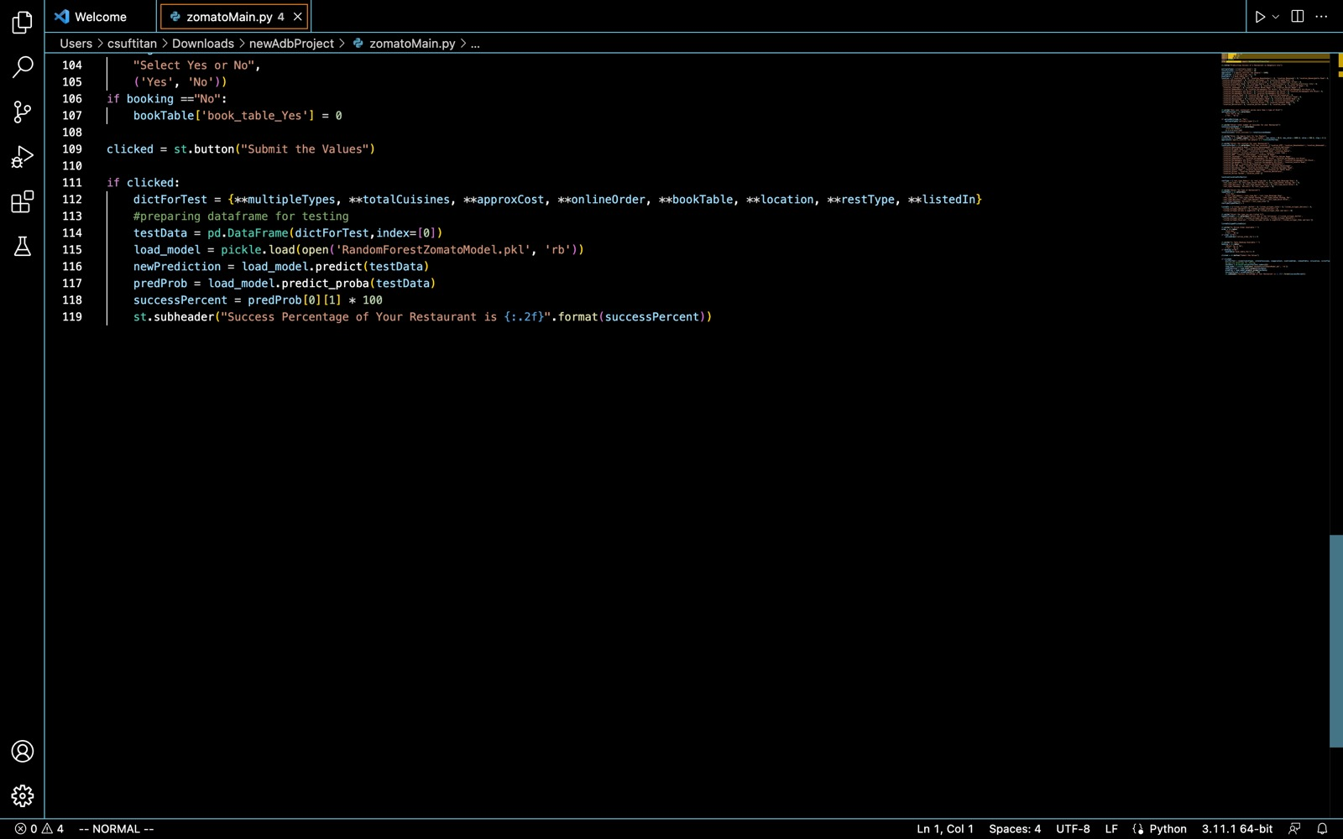

Slide 15
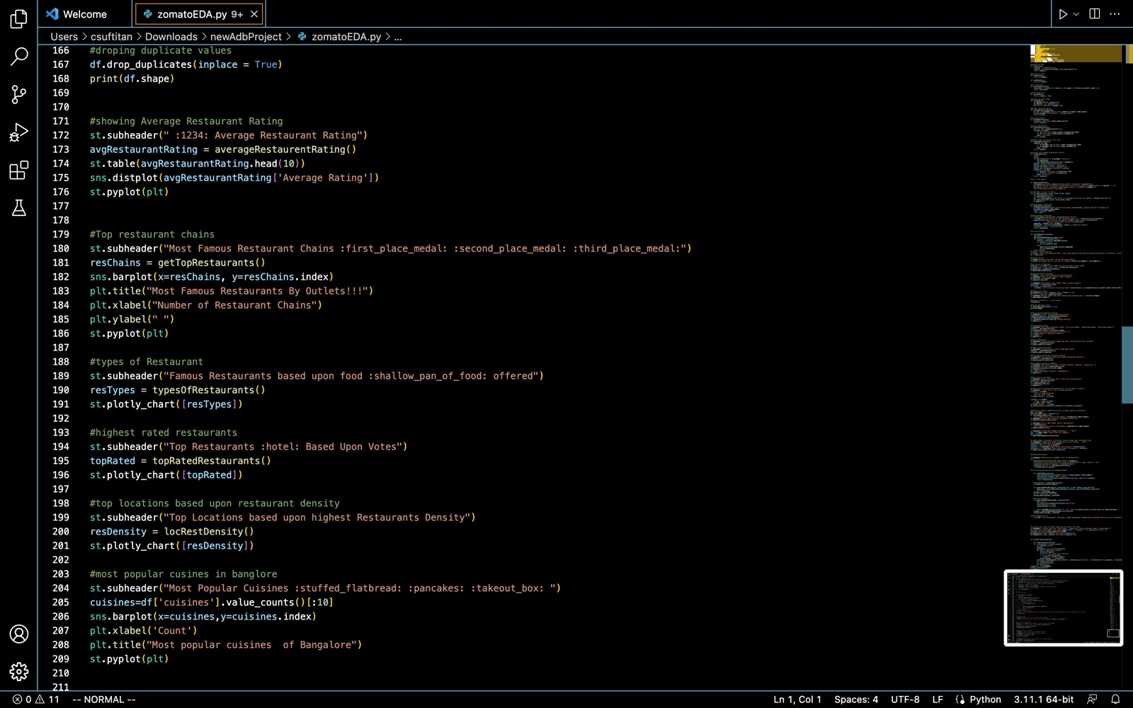

Slide 16
Demo
https://sakpalakshay-zomatostreamlit-zomatomain-boe7ic.streamlit.app

Slide 17

Summary
Our ML model is making predictions of how likely a restraint will be successful based on geographical location and cuisine type.

Slide 18



Thank You
Any Questions?

